Slide 1
FCPA: 2017 Mid-Year Review
June 14, 2017

Slide 2
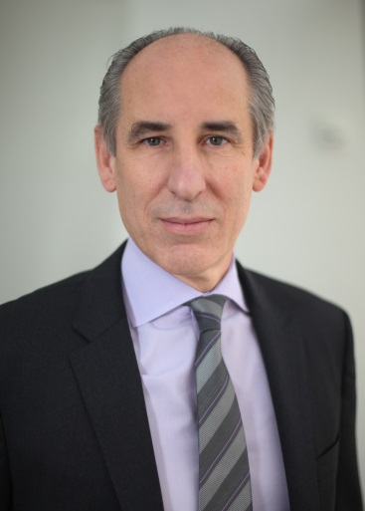
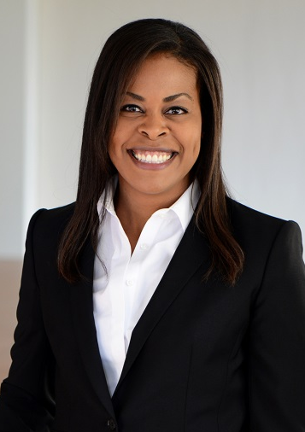
Presenters
Mark Srere
Partner, DC
(202) 508-6050
mark.srere@bryancave.com
Kristin Robinson
Associate, DC
(202) 508-6334
kristin.robinson@bryancave.com
Connect with us on LinkedIn
Mark (https://www.linkedin.com/in/mark-srere-2585689)
Kristin (https://www.linkedin.com/in/kristin-robinson-2b097a4)

Slide 3
Topics of Discussion
The FCPA: Brief Reminder
Overview of 2016 FCPA Enforcement
The New Administration: Reading the Tea Leaves
FCPA Pilot Program
2017 FCPA Actions and On-the-Horizon
Global Anti-Corruption Update
Compliance Reminders

Slide 4
The FCPA: Brief Reminder

Slide 5
Structure of FCPA
Antibribery Provisions
Prohibits bribery of foreign government or political officials
for the purpose of obtaining or retaining business or securing any improper business advantage
Mainly enforced as criminal violations by the Department of Justice
Books and Records Provisions
Requires SEC-registered or
reporting issuers to make and maintain accurate books and records and to implement
adequate internal accounting controls
Mainly enforced as civil violations by the Securities and Exchange Commission

Slide 6
Antibribery Prohibited Acts
It is unlawful for
  an “issuer,” “domestic concern,” or “any person acting within the territory of the United States”
  with “corrupt intent”
  directly or indirectly
  to offer, pay, promise to pay, or authorize payment
  of “anything of value”
  to a “foreign official”
  for the purpose of obtaining or retaining business or securing any improper business advantage

Slide 7
Jurisdiction
Any “issuer” that files reports to the SEC or trades equity or debt on a U.S. exchange
  Includes any foreign company that trades, for example, American Depository Receipts (ADRs) on a U.S. exchange
Any “domestic concern”
  Includes U.S. citizens, nationals, and residents as well as any entity (corporation, partnership, etc.) that is organized under the laws of the U.S. or a U.S. territory or that has its principal place of business in the United States
Any “person,” including an organization, wherever located, that, while in a U.S. territory, does any act in furtherance of the prohibited conduct
  Government argues minimum contacts include emails, telephone calls, transfers through correspondent bank accounts in U.S. intermediary banks

Slide 8
Overview of 2016 FCPA Enforcement

Slide 9
FCPA Statistics: Monetary Settlements
Monetary Settlements (DOJ / SEC)
  2016: $2.48 billion
  2015: $133 million
  2014: $1.56 billion
  2013: $731 million
  2012: $259 million
  2011: $509 million
  2010: $1.8 billion
Four Changes to Top Ten List in 2016
Largest 2016 Settlement
  Teva Pharmaceutical’s $519 million settlement to the SEC & DOJ

Slide 10
FCPA Statistics: Types of Settlements
Corporate Settlements (DOJ / SEC)
  2016: 27 companies
  2015: 11 companies
  2014: 10 companies
  2013: 12 companies
  2012: 12 companies
  2011: 15 companies
  2010: 23 companies
Individuals Charged by DOJ
  2016: 12 individuals
  2015: 8 individuals
  2014: 10 individuals
  2013: 12 individuals
  2012: 2 individuals
  2011: 10 individuals
  2010: 33 individuals

Slide 11
FCPA Top Ten Settlements
Siemens (Germany): $800 million (2008)
Alstom (France): $772 million (2014)
KBR / Halliburton (U.S.): $579 million (2009)
Teva Pharmaceutical (Israel): $519 million (2016)
Odebrecht/Braskem (Brazil): $420 million (2016)
Och-Ziff (U.S.): $412 million (2016)
BAE (UK): $400 million (2010)
Total SA (France): $398 million (2013)
VimpelCom (Holland): $398 million (2016)
Alcoa (U.S.): $384 million (2014)

Slide 12
The New Administration: Reading the Tea Leaves

Slide 13
Trump on FCPA (Before POTUS)
“It’s a horrible law and it should be changed.”
U.S. shouldn’t prosecute companies that are “getting business and creating jobs in this country.”
“. . . for this country to prosecute because something happened in India is outrageous.”
May 15, 2012 CNBC Squawk box interview

Slide 14
Sessions Pre-Confirmation
  “Will you commit to continued vigorous enforcement of the Foreign Corrupt Practices Act and the International Anti-Bribery Act of 1998?”
  “Yes, if confirmed as Attorney General, I will enforce all federal laws, including the Foreign Corrupt Practices Act and the International Anti-Bribery Act of 1998, as appropriate based on the facts and circumstances of each case.“
  Question from Senator Whitehouse,
  Sessions confirmation hearing
Notes:
- Response during confirmation hearings

Slide 15
Sessions Post-Confirmation
“Corruption harms free competition, distorts prices [and] often leads to substandard products and services coming into this country[,]…increases the cost of doing business, and hurts honest companies that don’t pay these bribes.”
Because the DOJ “wants to create an even playing field for law-abiding companies,” DOJ will “continue to strongly enforce the FCPA and other anti-corruption laws.”
“Congress enacted this law 40 years ago, when companies considered it a routine expense to bribe foreign officials in order to gain business advantages abroad”
Attorney General Jeff Sessions
Notes:
Described enforcement of the FCPA as “critical.”

Slide 16
Department of Justice
The strategy of the Trump administration’s anti-fraud effort “is to motivate companies and individuals to comply with the law” and “not to prosecute every company we can, or break our own records for the largest fines or longest prison sentences.”
Trevor McFadden
Deputy Attorney General
DOJ Criminal Division
Notes:
On the other hand…
Compare to former Enforcement Chief Andrew Ceresney’s trumpeting of record-setting settlements before the same audience in November 2016 (the American Conference Institute’s annual conference on the FCPA)
McFadden noted that some have concluded the DOJ “is no longer interested in prosecuting white-collar crime. I intend to dispel that myth.”

Slide 17
Investigation Timeline
“[Future FCPA investigations will] be measured in months, not years” as the DOJ makes “a concerted effort to move corporate investigations expeditiously.”
Trevor McFadden
Deputy Attorney General
DOJ Criminal Division
Notes:
Would greatly reduce the investigation expense borne by companies
Not unusual for an investigation to take 4-6 years

Slide 18
Securities & Exchange Commission
“Combatting corruption is an important governmental mission.”
[I plan to work] “with my fellow Commissioners, Enforcement Division staff, and other authorities in the U.S. and abroad to coordinate enforcement of the FCPA and other anti-corruption laws.”
SEC Chair Jay Clayton

Slide 19
International Cooperation
Global cooperation on the rise
  150% increase in annual requests from foreign prosecutors related to bribery and corruption investigations since 2011
  75% increase in annual requests from the U.S. to its foreign partners
DOJ sending prosecutor on detail to the U.K.
  Will work with Financial Conduct Authority
  First DOJ Criminal Division employee to work within a foreign regulatory agency on issues of white-collar crime
  Intended to foster information exchange and greater collaboration with foreign nations
Notes:
The last 5 years have seen 150% increase in the number of annual requests from foreign prosecutors for US-based evidence related to investigations
Announced in May--prosecutor on UK detail will work with the regulator, the Financial Conduct Authority, NOT the Serious Fraud Office

Slide 20
Corporate Prosecutions
“You’re saying BP is too big to fail. They’ve got employees, too. This is a dangerous philosophy. Normally, I was taught if they violated a law, you charge them. If they didn’t violate the law, you don’t charge them.”
  Attorney General Jeff Sessions
  Cole confirmation hearing, June 15, 2010

Slide 21
Trump Administration—Tough or Tender?
TOUGH
TENDER
AG committed to enforcing anti-corruption laws against corporations & individuals
SEC Chair and DOJ DAG recognize the importance of anti-corruption enforcement and U.S. partnership with domestic and foreign authorities
President made clear, unequivocal anti-FCPA statements
DAG says DOJ not focused on record fines and prosecutions
Greater effort to speed investigations, thereby saving companies money

Slide 22
FCPA PILOT PROGRAM

Slide 23
FCPA Pilot Program
Began April 5, 2016
Goal:
  formalize DOJ practice of rewarding cooperation
  incentivize prompt and voluntary disclosure
  issue declinations and reduce fines up to 50%

Slide 24
FCPA Pilot Program
In the first year:
22 companies self-disclosed FCPA violations vs. 13 in the previous year
18 FCPA matters resolved vs. 7 in the previous year
7 self-disclosed matters resolved
  5 declinations issued, all with disgorgement
  2 fine reductions of 50% and 30%, respectively
Notes:
-Companies that self-disclosed either weren’t prosecuted or entered into nonprosecution agreements. They didn’t face DPAs , guilty pleas or monitors.

Slide 25
FCPA Pilot Program
Program extended past April 5 expiration date
DOJ currently reviewing efficacy for an indeterminate period
Generally deemed to have had a significant impact on companies

Slide 26
FCPA Pilot Program
Future of the Program:
DOJ focus on the role of the individual in the corrupt conduct (as set forth in the Yates Memo)
Consideration of voluntary self-disclosure, cooperation and remediation efforts when making charging decisions
Intent to conclude investigations as soon as possible
Primary aim is to “motivate companies and individuals voluntarily to comply with the law”
Notes:
- Trevor McFadden, speaking at the Anti-Corruption, Export Controls & Sanctions Compliance Summit April 18 reiterated…

Slide 27
2017 FCPA Actions and On-the-Horizon

Slide 28
United States v. Orthofix International
No corporate settlements since Trump took office
  Formed in Curacao, HQ in Texas, conduct occurred in Brazil
  Allegations:
    Commissions paid to doctors employed by state-owned facilities
    Funding a cache of money used to pay bribes
  Will pay $14 million
Two individuals entered civil settlements with the SEC
  Executives with a hedge fund
  Bribed government officials through third parties and corrupt transactions
  Retained business and obtained special access to investment opportunities
Notes:
Orthofix sells medical devices and supplies to medical professionals around the world
Commercial reps paid 33-43% of sales price in commission, in turn paid 20-25% of sales price to doctors employed by state-owned facilities
Orthofix paid false invoices submitted by company related to a commercial rep; that money was used to pay bribes
Orthofix gave 70% discount to distributors that marked up the product and used the difference to pay bribes
Orthofix International settlement—Civil penalty, disgorgement, compliance monitor

Slide 29
United States v. Hoskins (D. Conn.)
Indictment alleges that Hoskins:
  Performed functions and services for other Alstom subsidiaries, including Alstom Power, Inc., located in the U.S.
  Authorized payments to consultants that were used as bribes to obtain a contract in Indonesia to build power stations for Indonesia’s state-owned and controlled electricity company
Court held:
  Non-resident foreign national, who is not an agent of a domestic concern or issuer, cannot be subject to criminal liability under the FCPA under an accomplice theory of liability where he or she is not an agent of a domestic concern and does not commit acts while physically present in US territory
On appeal to the Second Circuit; oral argument held March 2
Notes:
- Hoskins worked for Alstom UK and was assigned to Alstom Resources Management SA in France

Slide 30
United States v. Firtash (N.D. Ill.)
The allegations:
  Indian officials bribed in connection with a mining project
The facts:
  Project took place entirely in India
  Carried out by foreign companies with no ties to the U.S.
  Defendant possesses Ukrainian citizenship
  Never a citizen of, visitor to, or even a visa applicant for the U.S.
  No allegation of illicit acts occurring in or affecting the U.S.

Slide 31
United States v. Firtash (N.D. Ill.)
Claimed nexus to the U.S. through co-conspirators:
  Transferred funds through U.S. correspondent banks
  Traveled within the U.S.
  Used internet and email accounts hosted on U.S. servers
  Used a U.S.-located cellular phone on a U.S. network
No allegation that the acts were in furtherance of a conspiracy
Motion to Dismiss the Indictment filed May 9, will be briefed in July

Slide 32
Kokesh v. SEC
5-year statute of limitations on civil fines, penalties or forfeitures
SEC claimed unlimited look-back on disgorgement, terming it “equitable relief”
Supreme Court held that disgorgement:
  Is paid to victim and U.S. Treasury
  Is compensatory and punitive
  Must be treated as a penalty for statute of limitations purposes
Notes:
- Issue before the Supreme Court

Slide 33
GLOBAL ANTI-CORRUPTION UPDATE

Slide 34
Brazil: Operation Car Wash
Massive corruption probe began with a gas station network accused of money laundering in early 2014
Informant revealed comprehensive political corruption scheme
  State-run oil company Petrobras overcharged on contracts
  Surplus funds were used for campaign finance and to buy support for Worker’s Party
Results of corruption probe:
  Unprecedented cooperation among foreign governments
  “Whole pie” settlement approach
  At least $3.5 billion in fines paid to Brazil, Switzerland & U.S.
Notes:
- 80% paid to Brazil, 10% each to Switzerland & U.S>

Slide 35
France: Sapin II, passed November 8
New law aimed at preventing and fighting foreign bribery
  Applies to companies with 500+ employees and $100+ million in revenue
  Requires implementation of measures to prevent and detect corruption
Sapin II creates:
  The Agence Française Anticorruption (AFA), to provide oversight
  French Deferred Prosecution Agreements
  Certain whistleblower protections
Expands scope of French anti-corruption laws
Notes:
- The law applies to French citizens, a French resident, or a person carrying out all or part of its economic activity in France, regardless of whether the acts are committed within France

Slide 36
U.K.: Strengthened Enforcement by SFO
$800 million global settlement with Rolls-Royce (Jan. 2017)
  $605 million to Serious Fraud Office
  $170 million to Department of Justice
  $25.6 million to Ministério Público Federal
Paid bribes in at least twelve countries in exchange for confidential information or contract awards
Potential for future prosecution of 30+ individuals
Enforcement potentially weakened if subsumed by National Crime Agency

Slide 37
Compliance tips

Slide 38
Essential Elements to Compliance Program
Tone at the top – commitment from senior management and clearly articulated policy against corruption
Code of conduct, compliance policies & procedures
Oversight, autonomy, and resources
Risk assessment
Training and continuing advice
Incentives and disciplinary measures
Third-party due diligence
Confidential reporting and internal investigation

Slide 39
Criteria to Evaluate Compliance Program
DOJ’s new compliance counsel recently identified four criteria for evaluating the effectiveness of a compliance program:
  Addressing Risk – Does the compliance program demonstrate thoughtful design to address current risks?
  Active Compliance – How operational is the program (not a paper program)?
  Coordination – How well are stakeholders working with each other?
  Resources – How well is the program resourced?

Slide 40
Third Parties
Third parties remain one of the top risk areas for companies conducting business abroad
Best practices include:
  Due diligence on potential third parties
  FCPA compliance certification
  Continuous monitoring of third party transactions
  Auditing third party for compliance

Slide 41
Mergers & Acquisitions
DOJ continues to emphasize importance of effective anti-corruption due diligence in deal context
DOJ/SEC urge the following:
  Pre-acquisition due diligence
  Post-acquisition compliance integration
  Anti-corruption training
  FCPA audits
  Disclosures to government

Slide 42
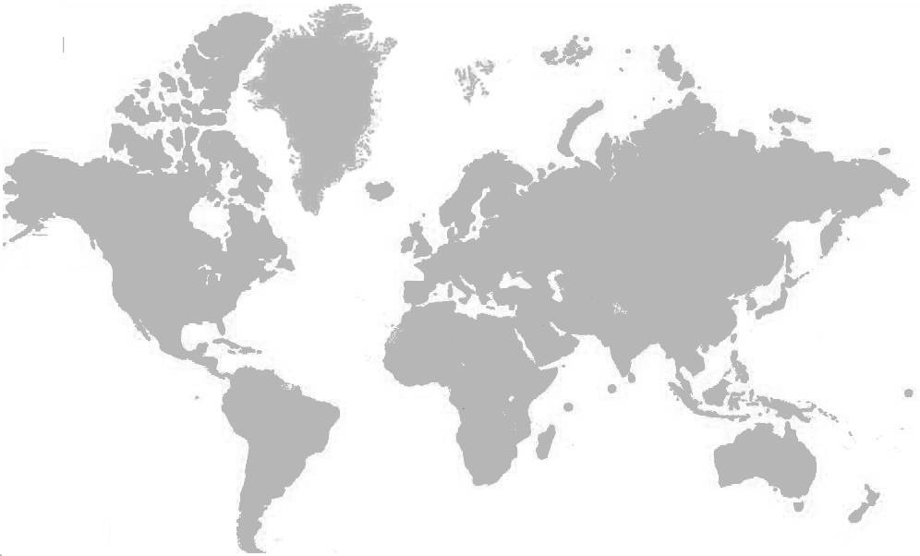
The Sales Personnel See…

Slide 43
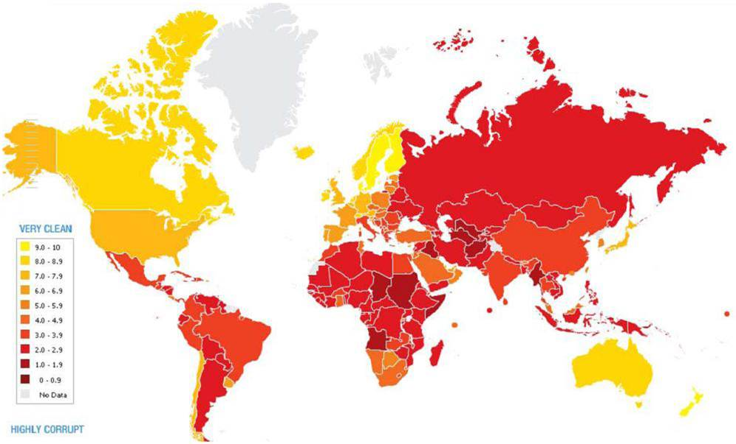
Prosecutors see…

Slide 44
QUESTIONS

